Slide 1
Introduction to .NET Application Development
Lecturer: Ngo Huy Bien
Software Engineering Department
Faculty of Information Technology
VNUHCM - University of Science
Ho Chi Minh City, Vietnam
nhbien@fit.hcmus.edu.vn

Slide 2

Objectives
To present what are software applications.
To present what are software applications development prerequisites.
To present how to develop software applications.

Slide 3

References
Antoni Olive. Conceptual Modeling of Information Systems. 2007.
Roger S. Pressman. Software Engineering -- A Practitioner’s Approach. 5th Edition. McGraw-Hill. 2001.
Dan Clark. Beginning C# Object-Oriented Programming. Apress. 2013.
Banani Roy and T.C. Nicholas Graham. Methods for Evaluating Software Architecture : A Survey. 2008.

Slide 4
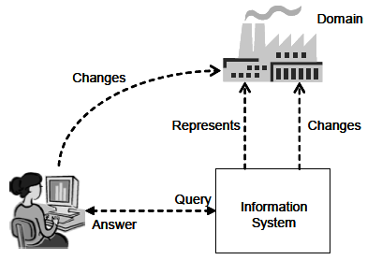
Information System [1]
An information system is a designed system that collects, stores, processes, and distributes information about the state of a domain.
A system is therefore considered to have three main functions:
Memory: to maintain a representation of the state of a domain.
Informative: to provide information about the state of a domain.
Active: to perform actions that change the state of a domain.

Slide 5

What is Software [2]
Software is (1) instructions (computer programs) that when executed provide desired function and performance, (2) data structures that enable the programs to adequately manipulate information, and (3) documents that describe the operation and use of the programs.

Slide 6
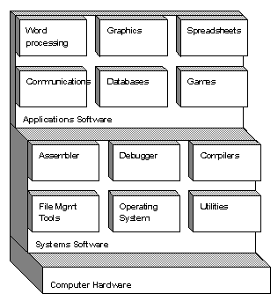
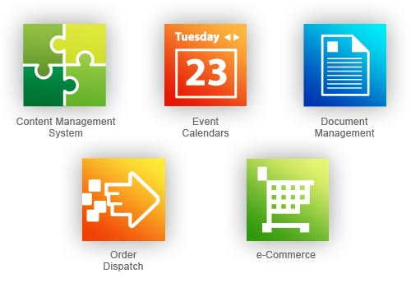
Software Applications
System software
Application software
Engineering/scientific software
Embedded software
Product-line software
Web applications
AI software

Slide 7
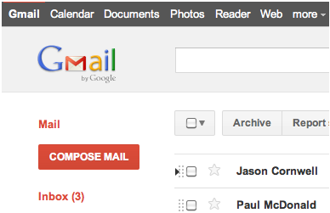
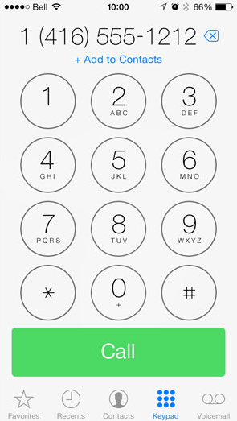
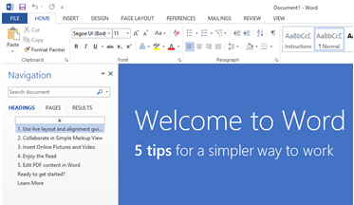
Application Types

Slide 8
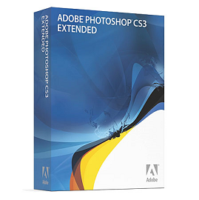


Tool Prerequisite
WHY?
Productivity
Reducing Cost
http://office.microsoft.com/en-us/
http://www.photoshop.com/
Source Code Version Control
http://git-scm.com/
https://github.com/

Slide 9
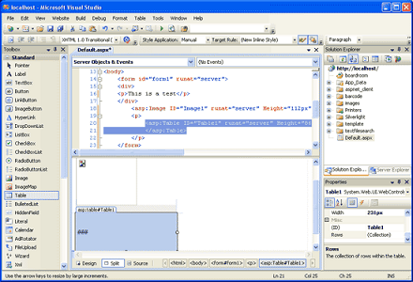
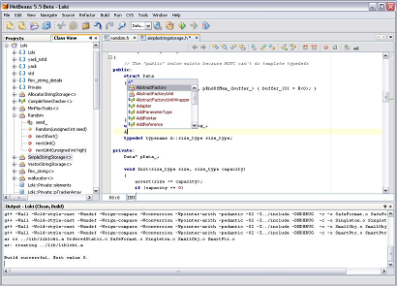
Integrated Development Environment
http://www.visualstudio.com/
https://netbeans.org/
https://www.eclipse.org/
A source code editor
A compiler and/or an interpreter
Build automation tools
A debugger

Slide 10





Development Platform

Slide 11
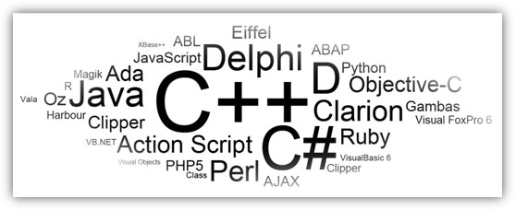
Programming Language [4]
Structured programming was supposed to improve software productivity and remove most software defects.
Object orientation was supposed to solve the problems of software productivity and adaptability, and make software highly reusable.

Slide 12

C# Language Basics? [3]
int counter = 1;
double? salary = null;
public struct Point
{
public int _x, _y;
public Point(int x, int y)
{
_x = x;
_y = y;
}
}
Point p1 = new Point(10,20);
string[] name = new string[4];
StringBuilder sb = new StringBuilder();
const Single pi = 3.14159265358979323846;
enum Manager
{
DeptManager,
GeneralManager,
AssistantManager,
}
Manager managerLevel = Manager.DeptManager;

Slide 13


Exercise 1
DAN CLARK. BEGINNING C# OBJECT-ORIENTED PROGRAMMING. APRESS. 2013.
APPENDIX C - INSTALLING THE REQUIRED SOFTWARE
ACTIVITY 5-1. TOURING VISUAL STUDIO.
ACTIVITY 5-2. USING THE DEBUGGING FEATURES OF VS.
JOSEPH ALBAHARI AND BEN ALBAHARI. C# 5.0 IN A NUTSHELL. FIFTH EDITION. O’REILLY MEDIA, INC. 2012.
CHAPTER 6. FRAMEWORK FUNDAMENTALS

Slide 14
OOP With C#?
class Employee
{
private string _name;
public string Name
{
get { return _name; }
set { _name = value; }
}
public Boolean Login(string name, string password)
{
return true;
}
}
public abstract class Account
{
public abstract string GetAccountInfo();
}
public class SavingsAccount : Account
{
public override string GetAccountInfo()
{
return "Printing savings account info";
}
}

Slide 15
Exercise 2
DAN CLARK. BEGINNING C# OBJECT-ORIENTED PROGRAMMING. APRESS. 2013.
ACTIVITY 6-1. CREATING THE EMPLOYEE CLASS
ACTIVITY 6-2. CREATING CONSTRUCTORS AND OVERLOADING METHODS.
ACTIVITY 7-1. IMPLEMENTING INHERITANCE USING BASE AND DERIVED CLASSES.
ACTIVITY 7-2. OVERRIDING BASE CLASS METHODS.

Slide 16
.NET Collections With C#?
List<Customer> customerList = new List<Customer>();
customerList.Add(new Customer
("WHITC", "White Clover Markets", "Karl Jablonski"));
customerList.Add(new Customer
("RANCH", "Rancho grande", "Sergio Gutiérrez"));
customerList.Add(new Customer
("ALFKI","Alfreds Futterkiste","Maria Anders"));
foreach (Customer c in customerList)
{
Console.WriteLine(“Id: {0} Company: {1} Contact: {2}”, c.CompanyId, c.CompanyName, c.ContactName);
}

Slide 17
Exercise 3
DAN CLARK. BEGINNING C# OBJECT-ORIENTED PROGRAMMING. APRESS. 2013.
ACTIVITY 9-1. WORKING WITH ARRAYS AND ARRAY LISTS
ACTIVITY 9-2. IMPLEMENTING AND EXTENDING GENERIC COLLECTIONS
ACTIVITY 9-3. IMPLEMENTING STACKS AND QUEUES

Slide 18
Streams And I/O With C#?
public static string WriteLog(string logPath, string logInfo)
{
using (FileStream oFileStream = new FileStream(logPath, FileMode.Open, FileAccess.Write)){
using (StreamWriter oStreamWriter = new StreamWriter(oFileStream))
{
oFileStream.Seek(0, SeekOrigin.End);
oStreamWriter.WriteLine(DateTime.Now);
oStreamWriter.WriteLine(logInfo);
oStreamWriter.WriteLine();
}
}
return "Info Logged";
}

Slide 19
Exercise 4
JOSEPH ALBAHARI AND BEN ALBAHARI. C# 5.0 IN A NUTSHELL. FIFTH EDITION. O’REILLY MEDIA, INC. 2012.
CHAPTER 15. Streams and I/O

Slide 20
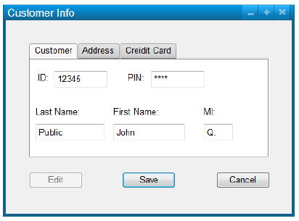
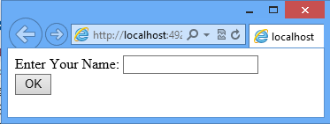
.NET Controls With C#? [3]
using System.Windows.Controls;
private TextBox phoneTextBox;
private void btnSave_Click(
object sender, EventArgs e)
{
}
private void btnCancel_Click(
object sender, EventArgs e)
{
}

Slide 21
Exercise 5
DAN CLARK. BEGINNING C# OBJECT-ORIENTED PROGRAMMING. APRESS. 2013.
ACTIVITY 8-1. ISSUING AND RESPONDING TO EVENT MESSAGES
ACTIVITY 8-2. IMPLEMENTING EXCEPTION HANDLING AND STATIC METHODS
ACTIVITY 11-1. WORKING WITH WINDOWS AND CONTROLS
ACTIVITY 12-1. WORKING WITH WEB PAGES AND SERVER CONTROLS
ACTIVITY 12-2. MAINTAINING STATE IN A WEB APPLICATION
ACTIVITY 13-1. WORKING WITH CONTROLS

Slide 22
ADO.NET With C#?
SqlConnection pubConnection = new SqlConnection();
string connString;
try
{
connString = "Data Source=drcsrv01; Initial Catalog=pubs; Integrated Security=True";
pubConnection.ConnectionString = connString;
pubConnection.Open();
}
catch (SqlException ex) { throw ex; }
finally { pubConnection.Dispose(); }

Slide 23
Exercise 6
DAN CLARK. BEGINNING C# OBJECT-ORIENTED PROGRAMMING. APRESS. 2013.
ACTIVITY 10-1. RETRIEVING DATA FROM A SQL SERVER DATA BASE
ACTIVITY 10-2. WORKING WITH DATA SET OBJECTS
ACTIVITY 11-2. WORKING WITH DATA BOUND CONTROLS
ACTIVITY 11-3. WORKING WITH DATA TEMPLATES
ACTIVITY 12-3. BINDING A GRIDVIEW CONTROL
ACTIVITY 13-2. WORKING WITH DATA -BOUND CONTROLS
ACTIVITY 13-3. WORKING WITH DATA TEMPLATES

Slide 24
Concurrency & Asynchrony With C#?
static void Main()
{
// Kick off a new thread
Thread writeYThread = new Thread (WriteY);
writeYThread.Start(); // running WriteY()
// Simultaneously, do something on the main thread.
for (int i = 0; i < 1000; i++) Console.Write ("x");
}
static void WriteY()
{
for (int i = 0; i < 1000; i++) Console.Write ("y");
}

Slide 25
Exercise 8
JOSEPH ALBAHARI AND BEN ALBAHARI. C# 5.0 IN A NUTSHELL. FIFTH EDITION. O’REILLY MEDIA, INC. 2012.
CHAPTER 14. CONCURRENCY & ASYNCHRONY
DAN CLARK. BEGINNING C# OBJECT-ORIENTED PROGRAMMING. APRESS. 2013.
ACTIVITY 8-3. CALLING METHODS ASYNCHRONOUSLY

Slide 26

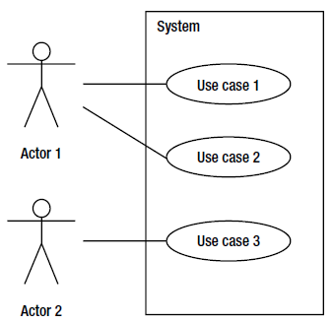
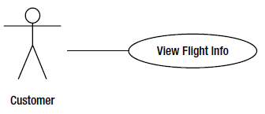
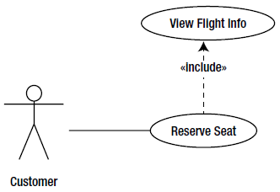

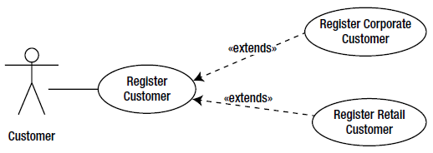
Developing a SRS? [3]

Slide 27
Exercise 9
DAN CLARK. BEGINNING C# OBJECT-ORIENTED PROGRAMMING. APRESS. 2013.
ACTIVITY 2-1. CREATING A USE CASE DIAGRAM

Slide 28

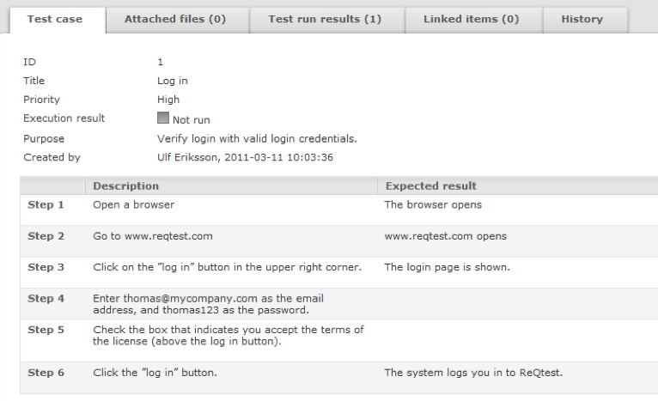
Developing a Test Plan?

Slide 29
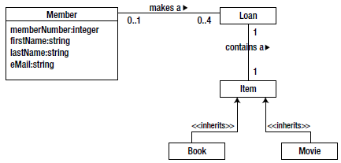
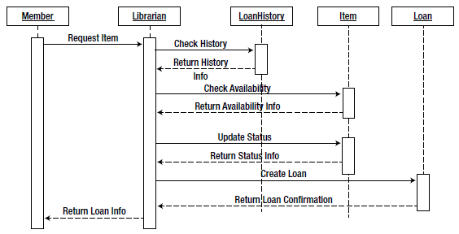
Creating Detailed Design [3]

Slide 30
Exercise 11
DAN CLARK. BEGINNING C# OBJECT-ORIENTED PROGRAMMING. APRESS. 2013.
ACTIVITY 2-2. CREATING A CLASS DIAGRAM
ACTIVITY 3-1. CREATING A SEQUENCE DIAGRAM
ACTIVITY 3-2. CREATING AN ACTIVITY DIAGRAM

Slide 31
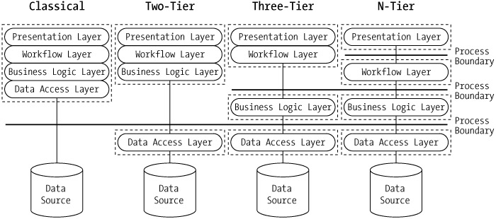
Creating An Architecture?

Slide 32
Exercise 10
HTTP://MSDN.MICROSOFT.COM/EN-US/LIBRARY/BB384570.ASPX
HTTP://WWW.CODEPROJECT.COM/ARTICLES/439688/CREATING-ASP-NET-APPLICATION-WITH-N-TIER-ARCHITECT
HTTP://WWW.CODEPROJECT.COM/ARTICLES/294022/WALKTHROUGH-CREATING-AN-N-TIER-DATA-APPLICATION-WI
HTTP://WWW.CODEPROJECT.COM/ARTICLES/70061/ARCHITECTURE-GUIDE-ASP-NET-MVC-FRAMEWORK-N-TIER-EN

Slide 33


Slide 34
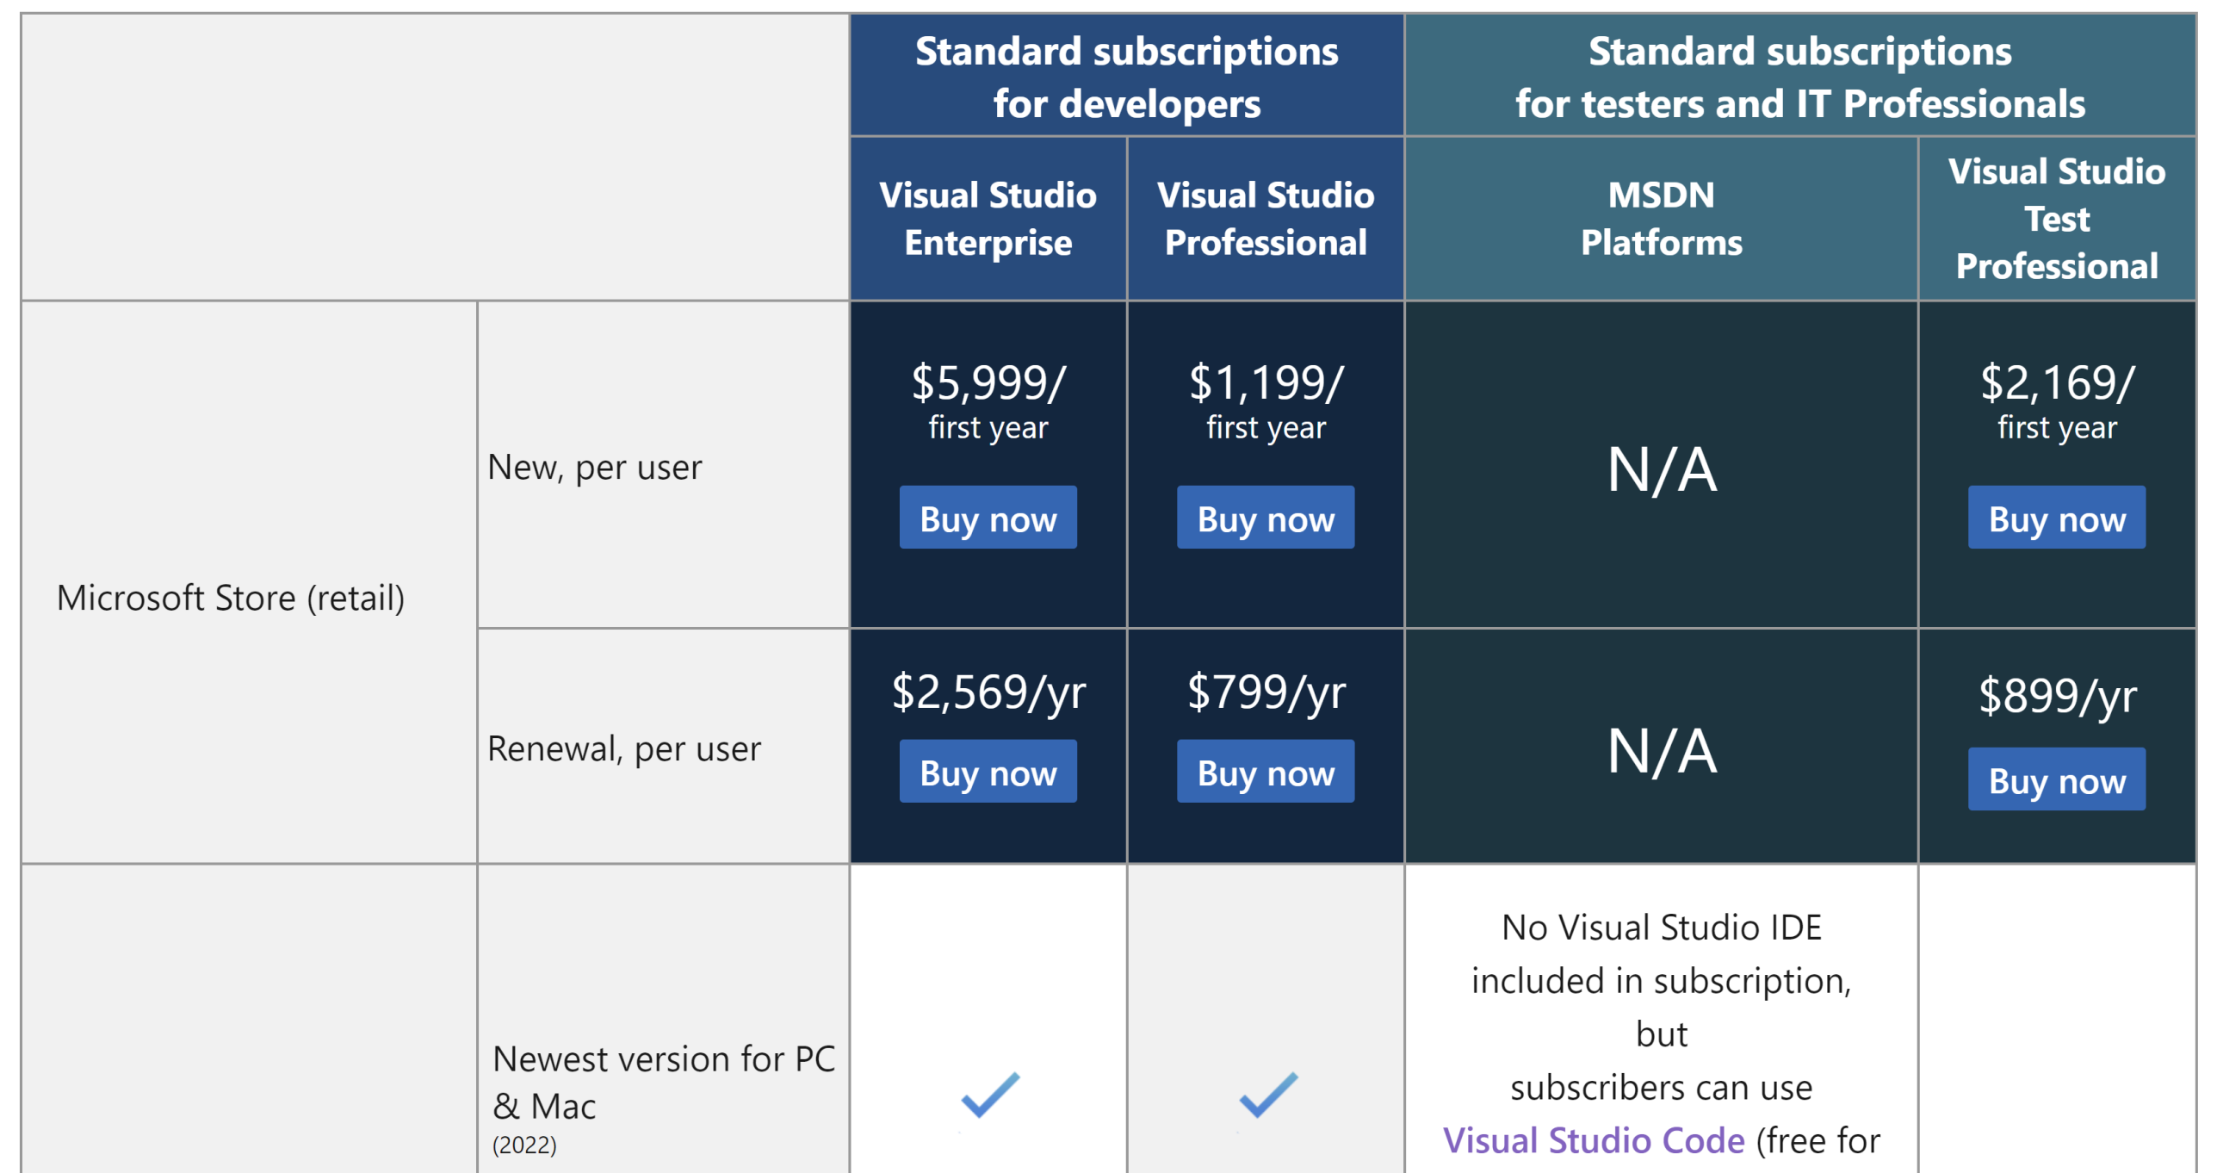
Purchase Visual Studio
Standard subscriptions: https://visualstudio.microsoft.com/vs/pricing-details/
Resellers: https://appsource.microsoft.com/en-us/marketplace/partner-dir

Slide 35
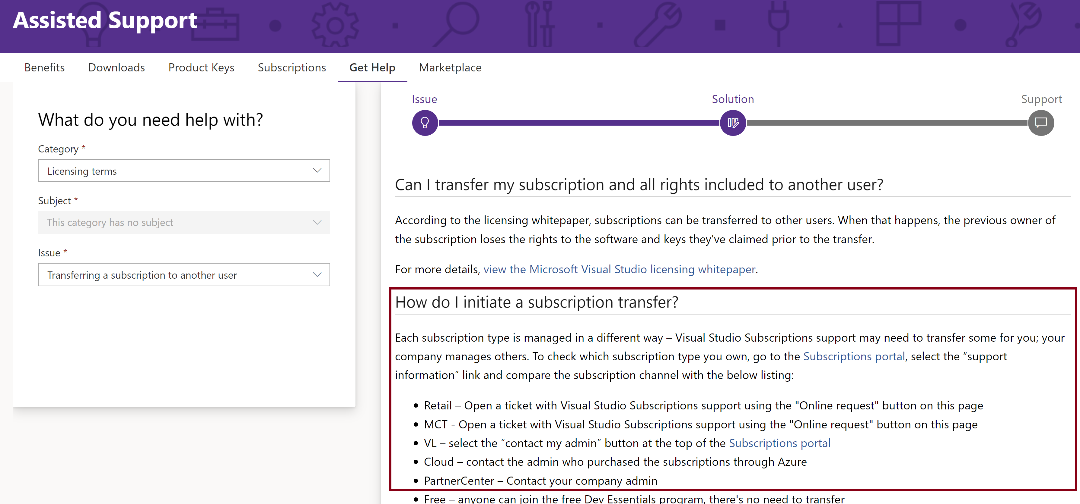
Transfer VS Subscription
Log in https://my.visualstudio.com
Click on https://my.visualstudio.com/GetHelp/AssistedSupport?mkt=en-us
Select “Category” = “Licensing terms”
Select “Issue” = “Transferring…”

Slide 36

Thank You & See You Again

